Slide 1
Skateboard Parts Database
By Joseph Salafia, Jax Deary, and Spencer Gayton

Slide 2
Current Problem
Many skateboard enthusiasts who wish to upgrade from factory complete boards or low-quality toy skateboards often face the challenge of selecting the right parts for their needs.
Our MySQL database offers a solution by compiling a selection of top brands and their products, allowing beginners to experiment with different size options and explore compatible combinations. By using our database, skaters can make more informed purchases either online or at a skate shop, giving them the confidence to take their skills to the next level.

Slide 3
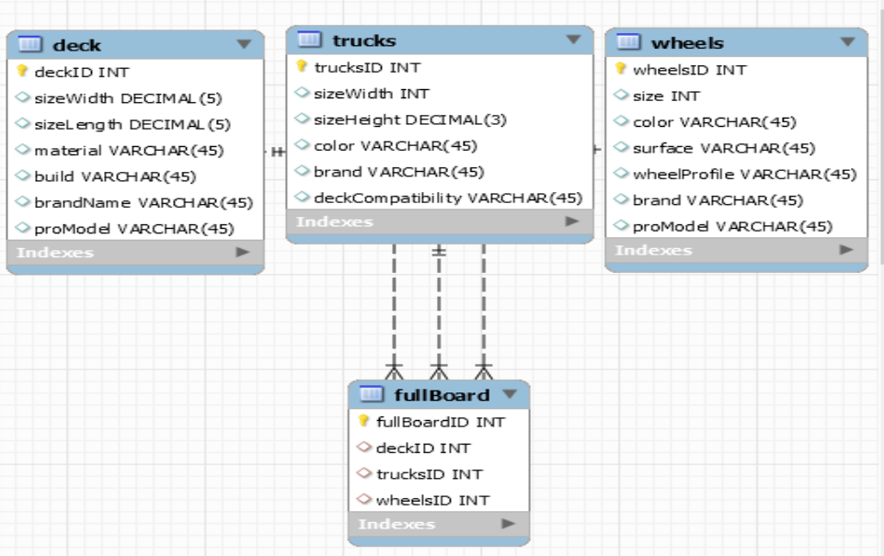
ERD

Slide 4
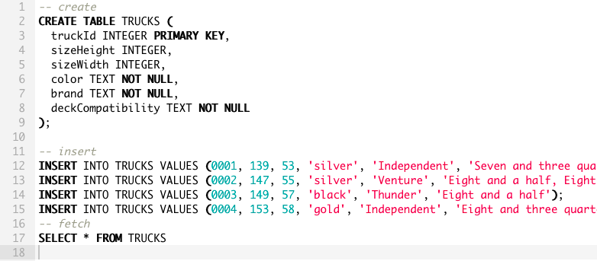
Query 1 Entering in new truck sizes

Slide 5
Query Output
Output:
truckId sizeHeight sizeWidth color brand deckCompatibility
1 139 53 silver Independent Seven and three quarters
2 147 55 silver Venture Eight and a half, Eight and a quarter
3 149 57 black Thunder Eight and a half
4 153 58 gold Independent Eight and three quarters

Slide 6
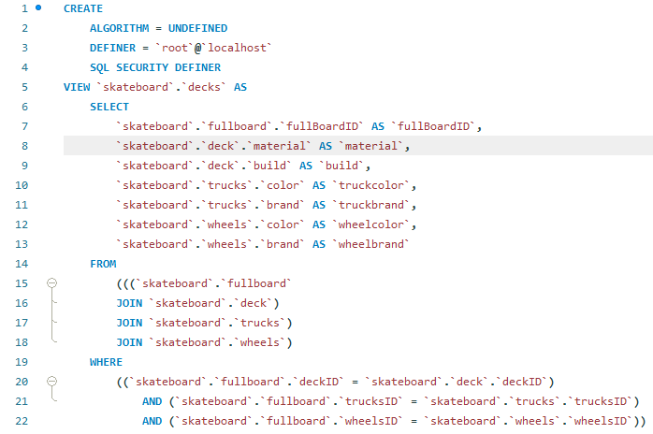
Query 2 Creating a Deck with Colors in Mind

Slide 7
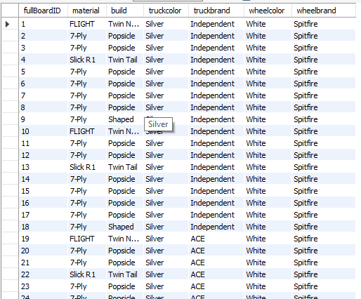
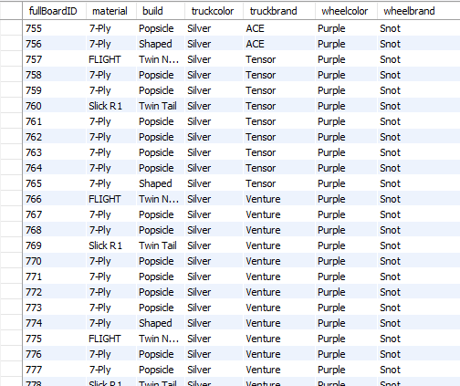
Query Output
Each part of the board is listed with its brand and color.

Slide 8
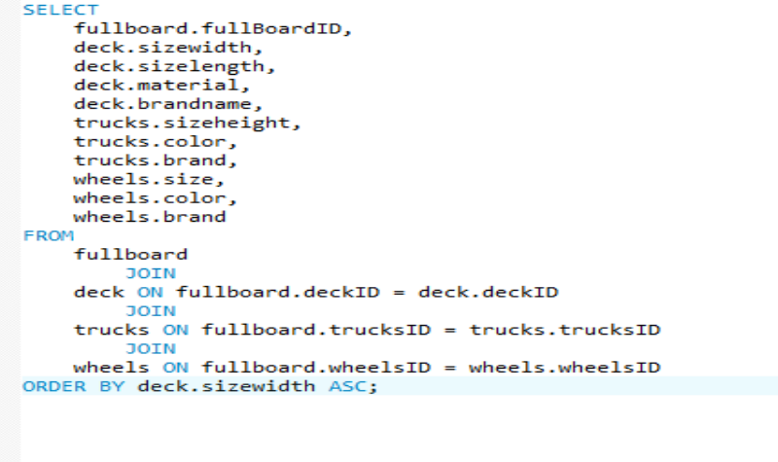
Query 3: Sorting decks by size

Slide 9
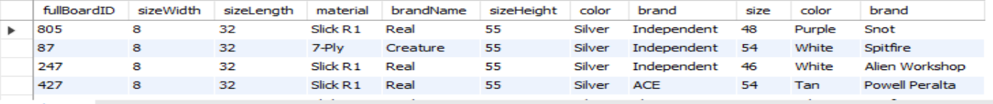
Query Output

